Slide 1
Degenerative joint disease
(osteoarthritis )

Slide 2
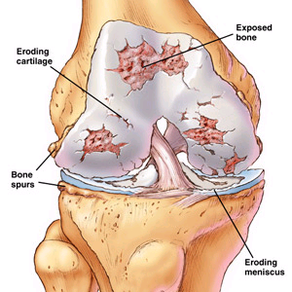
Definition
Osteoarthritis (OA) is a non-inflammatory degenerative joint disease characterized by progressive loss of articular cartilage with associated new bone formation and capsular fibrosis.
There is a disparity between the stress applied to the joint and the chondrocyte response. 'wear vs. repair’ causing failure of chondrocytes to repair damaged cartilage.
OA usually involves all the tissues that form the synovial joint.

Slide 3
Epidemiology
OA is the most common joint disease
Usually affects elderly ( older than 60 years )
Usually affects female > male
Most common affected joints :
knee(most common ) > hip > hand > spine > other joints

Slide 4
Classification and Etiology:
A) Primary :
No obvious cause (idiopathic )
Usually, elderly >60 years
Due to the disparity between wear (stress ) and repair ( chondrocyte response )
Possible causes are obesity, aggressive sports, and habits of daily life might be blamed.

Slide 5
b) secondary :
Usually young age ( 20 -30 years )
Possible causes :
Congenital: DDH, Perthes disease
Traumatic: malunited intra-articular fracture
Infection: septic, TB arthritis
Metabolic: hemochromatosis, Wilson disease, Gaucher disease, gout.
Endocrine: acromegaly, hyperparathyroidism
Neuropathies: DM, Charcot disease
Others: hemophilia

Slide 6
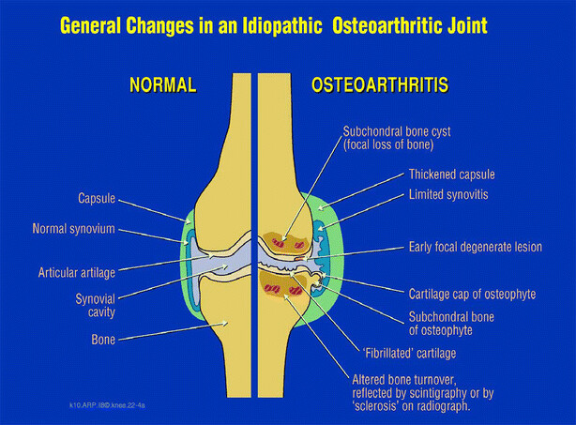
Pathological changes :
OA usually involves all the tissues that form the synovial joint:
1)Articular cartilage: increase water content, decrease proteoglycan, organization, and orientation of collagen meshwork is lost …. Causing softening, fibrillation of articular cartilage and deep clefts appear in its substance….. Eventually, articular cartilage is lost in areas of maximum mechanical stress.
2)Synovium: inflammation, thickened, hypervascularity.
3) Subchondral bone: sclerosis, cysts formation, and Proliferative changes also occur at the joint margins with formation of osteophytes.
4)Capsule: Repetition of the inflammation and healing process causes capsular fibrosis and limitation of joint motion.

Slide 7
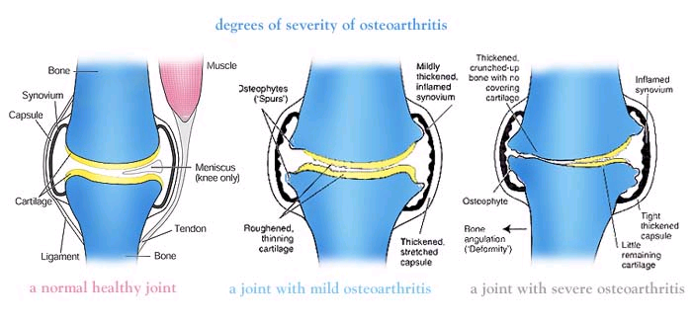
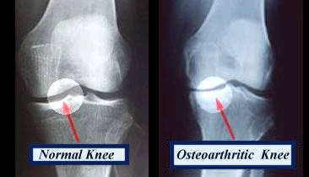

Slide 8
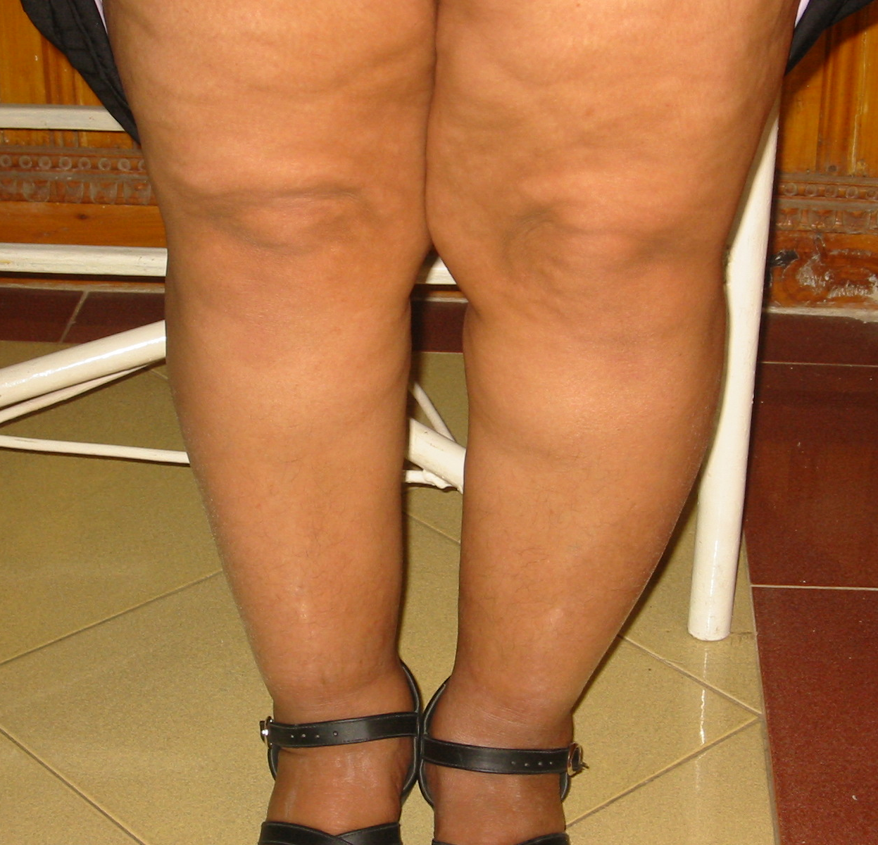
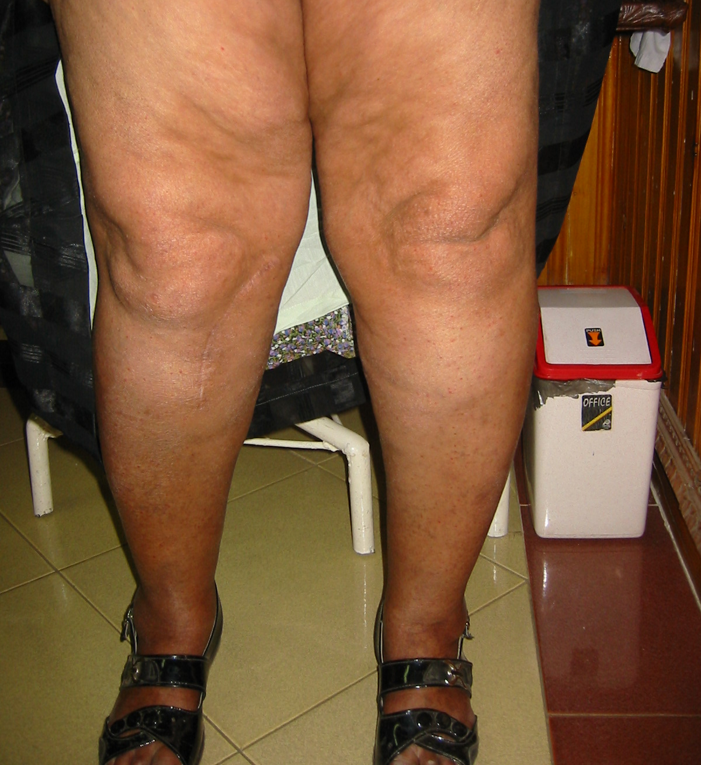
Clinical picture :
History:
Typically, there is history of chronic knee pain, and episodes of increased pain, which is relieved by analgesics and NSAIDs. The pain increases with walking and at night.
Physical signs:
1. Local joint line tenderness.
2. Effusion may be present.
3. Limitation of range of motion.
4. Deformity (varus, valgus, flexion deformity)

Slide 9
Investigations :
Labs:
Normal CBC
Normal ESR (less than 40)
Normal CRP
Normal RF, serum uric acid
Clear viscous synovial fluid
Synovial fluid analysis indicates a low white cell count <2000/ul.
These investigations should only be performed if secondary causes of OA are clinically suspected .

Slide 10
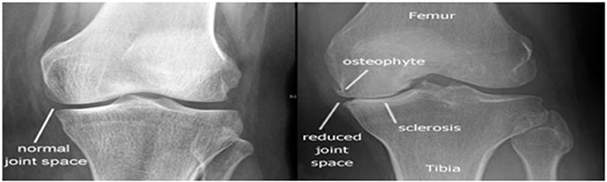
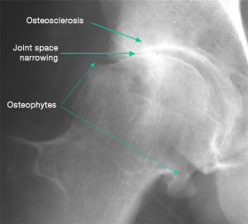
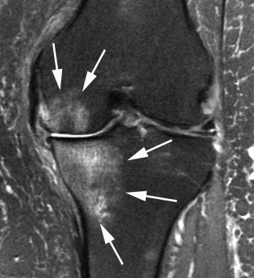
B) Imaging :
plain x-ray ( show Fairbank’s changes ):
joint space narrowing
2) subchondral sclerosis
3) Subchondral cysts
4) Marginal osteophytes, loose bodies.
5) Bone destruction and joint deformity ( late cases ).
MRI: identify internal derangement of the knee joint.

Slide 11
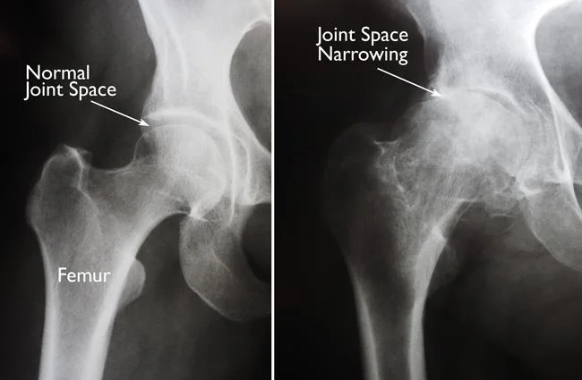

Slide 12
Treatment :
conservative: 1st line in the management of osteoarthritis :
Protect affected joints from overloading (weight loss, use of walking stick).
Instructions to avoid some living habits e.g. squatting positions, climbing stairs, especially during episodes of increased pain and swelling.
Exercise the muscles around the joint to avoid wasting and to keep the range of joint movement.
Medical treatment:
1) Analgesics such as NSAIDs relieve pain and control episodes of inflammation. NSAIDs can cause stomach upset, cardiovascular problems, bleeding problems, and liver and kidney damage. Topical NSAIDs such as gels, applied to the skin over the affected joint, have fewer side effects and may relieve pain just as well.
2) Glucosamine & chondroitin supply: delay cartilage degeneration.
3)Intraarticular injections: hyaluronic acid, and PRP (platelet-rich plasma ) : may reduce pain and stiffness for a limited time.

Slide 13
B) operative treatment :
Indications :
Progressive increase in joint pain and stiffness without any response to conservative treatment
marked joint deformity
X-ray signs of joint destruction
Decreased activity of daily living

Slide 14
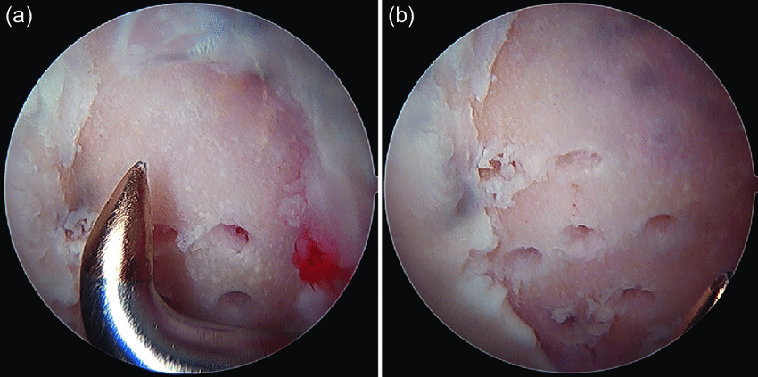
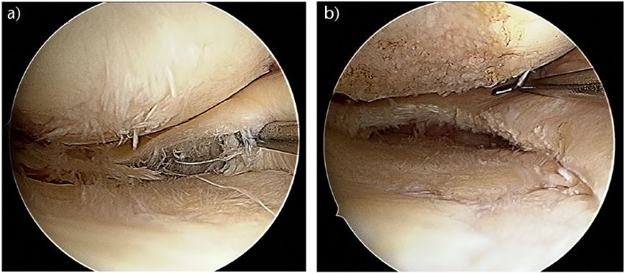
1) arthroscopic procedures :
Debridment and lavage
Loose body removal
Microfracture in areas of ulcers with exposed subchondral bone
Partial meniscectomy for associated degenerative meniscus tears.

Slide 15
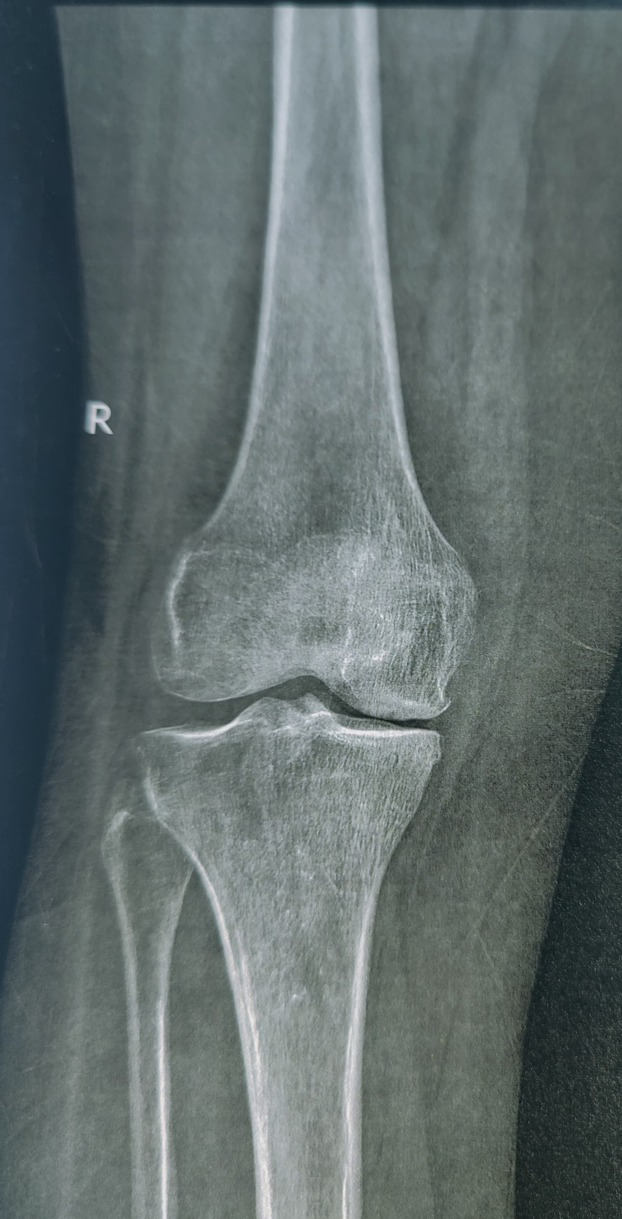
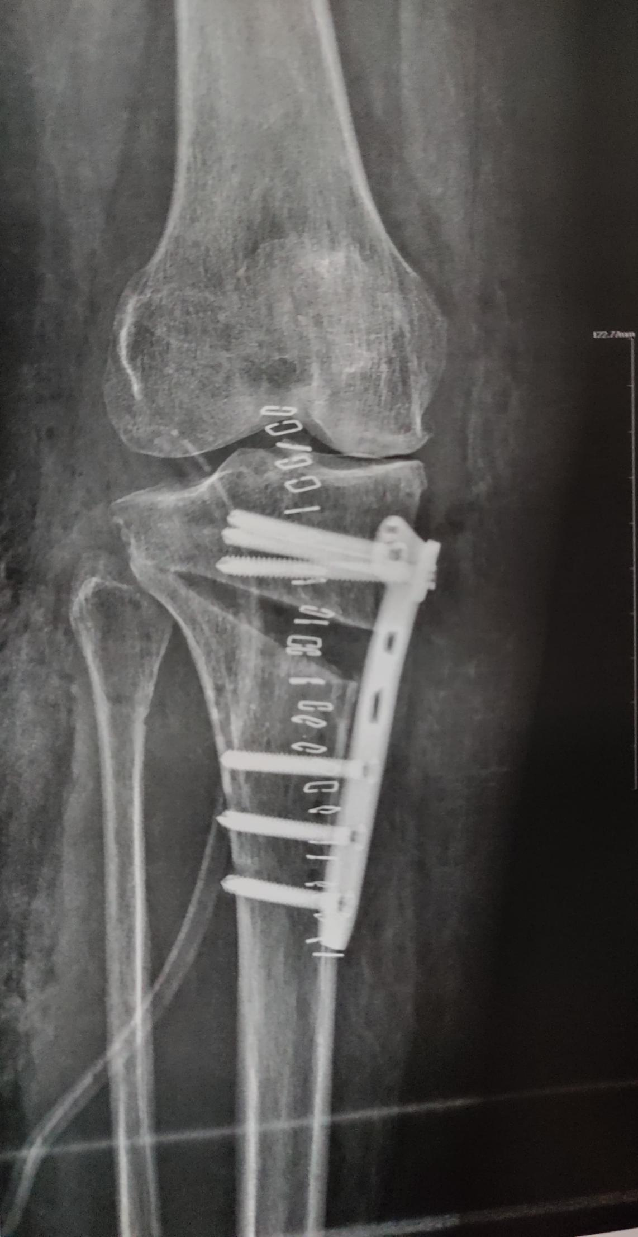
2) Realignment procedures (corrective osteotomies) :
Redistribute weight-bearing load when the disease affects mainly one joint compartment in young active patients.
Most common is valgus producing HTO in case of knee OA with genu varus deformity

Slide 16
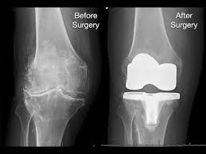
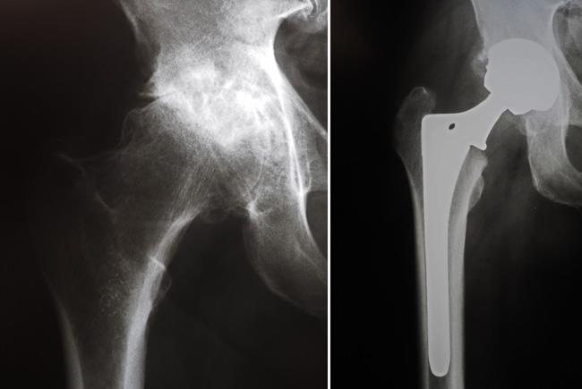
3) Arthroplasty ( joint replacement ) :
in elderly with advanced osteoarthritis with involvement of all compartments of the joint.

Slide 17
Thank you

